Slide 1
AS Economics and Business PED unit 2b
By Mrs Hilton for revisionstation

Slide 2
Lesson Objectives
To be able to describe the terms elastic and inelastic demand
To be able to identify a range of goods and if they are elastic or inelastic
To be able to calculate PED

Slide 3
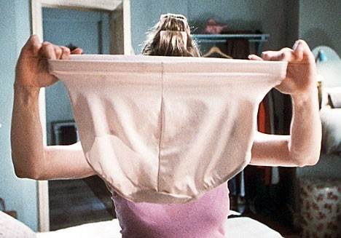
Starter
What do you think of when I say elastic?

Slide 4
ELASTICITY

Slide 5
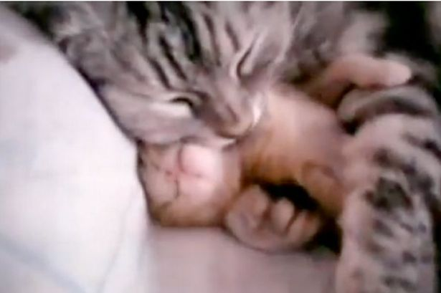
Elasticity
Its all about proportion of response to something.
How do you feel about
Kittens?
You have a response to this question. Maybe you like them, maybe you don’t. This is a moderate response.
Maybe you HATE them maybe you LOVE them this is a much stronger response.
Was your response in the right proportion to the question?

Slide 6
Elasticity is about kittens then?
When there is a change in something – like price this causes a change in the quantity that firms are prepared to supply.
We can measure this change as e l a s t i c i t y

Slide 7
What does elasticity measure then if its not kittens...
Elasticity measures the proportion of response that a business has to the change in price.
If a business supplies more than is proportionate to the change in price then its price elastic
If the business supplies less than is proportionate then its inelastic
If a business supplies the right amount this is unit elasticity of demand

Slide 8
PED

Slide 9
Price elasticity of demand
This measures a consumers responsiveness to a change in the price.
If total consumer expenditure increases in response to a price fall – then demand is elastic (Bought more because its cheaper)
If total consumer expenditure decreases or does not change in response to a price fall then demand is inelastic (Can’t buy something else, as only this good will do the job so no matter what the cost have to buy it anyway)

Slide 10
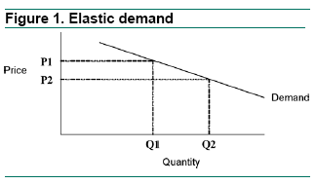
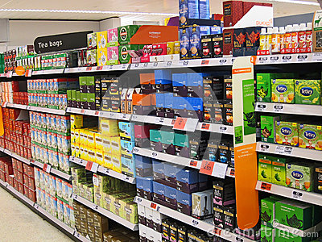
Elastic demand
If demand is responsive to a change in price then it is elastic
If a supermarket reduces cost of tea bags, demand will go up.
If they put up the price of teabags higher than all the other supermarkets then demand will fall.

Slide 11
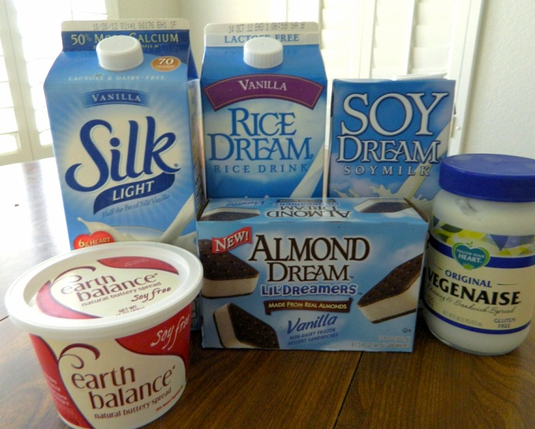
Goods that are elastic
Goods with close substitutes
Tea bags (can switch to coffee or other hot beverages)
Coffee (can switch to hot chocolate)
Meat (can switch to fish or veggie)
Unbranded clothes (can easily switch to other clothes if the prices goes too high)
Always other products that consumers can switch too, these are substitutes

Slide 12
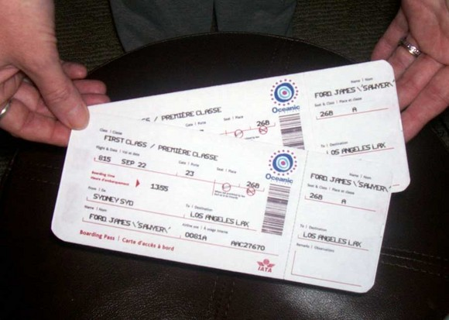
Elastic goods
Plane tickets – are elastic – why?
Video
click here
Notes:
Lots of substitutes can take a car or another airline

Slide 13
Elastic
A price cut will change demand
E l a s t i c
So if your product is price elastic then cutting the price will increase demand and possibly profits. (Depends if you cut your price below your costs) £££££

Slide 14
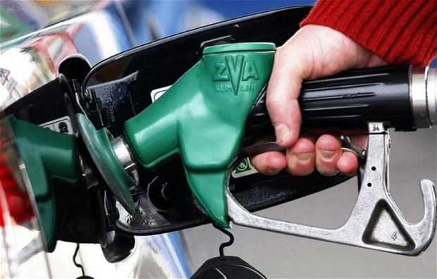
Inelastic demand
This is a product that demand does not change if the price is changed.
What are the substitutes for petrol?

Slide 15
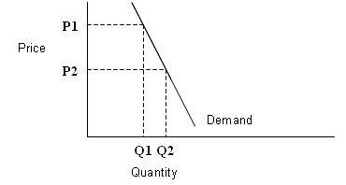
Inelastic demand
A Price cut brings little change in demand.
Price increases also have little change in demand and will increase revenue.
Necessities are inelastic – even if the price goes up still have to buy them – if there are no suitable substitutes..

Slide 16
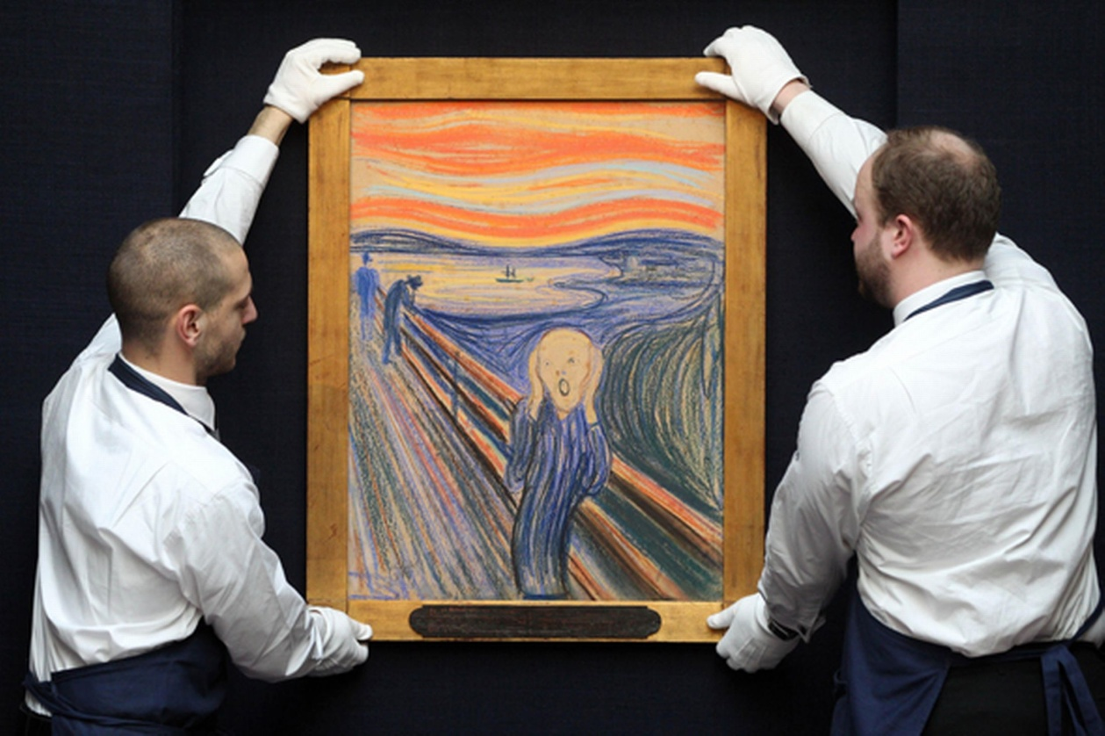
Inelastic goods
Original oil paintings – why?
Medicines – why?
Notes:
Only one painting – no substitutes
Medicine is a necessity

Slide 17
Ooo goody a formula
To calculate the price elasticity of demand we use a formula, PED =:
% change in Q demanded
__________________________________
% change in price

Slide 18
Levels of elasticity
Name | Description | PED Value
Perfectly inelastic | Price change No change in Q demanded | 0
Inelastic | Price change Small change in Q demanded not proportionate to price change | Between 0 and -1
Unit Elasticity | Price change Q Demand is same as price change | -1
Elastic | Price change Large change in Q demanded not proportionate to price change | Above -1
Perfectly elastic | Price change No sales at all | ∞

Slide 19
Lets try some calcs – you need a calculator
We drop the price of tea bags by 10% which has caused a 20% rise in demand
We have raised the price by 10% which has caused a drop in demand by 5%
?
Notes:
20/ -10= -2 elastic
-5/10 = -0.5 inelastic

Slide 20
Sample question
One estimate is that a 10% reduction in the price of Tesco iPhone contracts would increase demand by 4%. Calculate and comment on the price elasticity of demand in this case. [4]

Slide 21
Answer
Showing the correct formula (2 marks)
% Change in Quantity Demanded
__________________________
% Change in Price
OR If no calculation is given or incorrect formula used then 1 mark is available for a definition of PED e.g. measures the responsiveness of demand to a change in the price
Application: 1 mark is available for the correct figures:
+4% = - 0.4
-10%
Analysis: up to 1 mark for stating that the PED is 0.4 and
therefore demand is price inelastic.

